Slide 1

Advance Mobile and Cellular Communication Networks
MIT-
By-
Jesmin Akhter
Associate Professor
Institute of Information Technology
Jahangirnagar University

Slide 2

Lecture 04 & 05 GSM

Slide 3
GSM -Global System for Mobile Communications
GSM originally is developed by the European Telecommunications Standards Institute (ETSI) to describe the protocols for second-generation digital cellular networks used by mobile devices
2G networks developed as a replacement for first generation (1G) analog cellular networks and the GSM standard originally described as a digital, circuit-switched network optimized for full duplex voice telephony
This expanded over time to include data communications, first by circuit-switched transport, then by packet data transport via GPRS (General Packet Radio Services) and EDGE (Enhanced Data rates for GSM Evolution)
Subsequently, the 3GPP developed third-generation (3G) UMTS standards, followed by fourth-generation (4G) LTE Advanced standards.
Notes:
The Universal Mobile Telecommunications System (UMTS) is a third generation mobile cellular system for networks based on the GSM standard. Developed and maintained by the 3GPP (3rd Generation Partnership Project), UMTS is a component of the International Telecommunications Union IMT-2000 standard set

Slide 4
The characteristics of the initial GSM Standard
Fully digital system utilizing the 900 MHz frequency band
8 full rate or 16 half rate TDMA channels per carrier
Traffic Channels may be:
Full Rate (TCH/F)
one channel per user
13 kbps voice, 9.6 kbps data
or
Half Rate (TCH/H)
one channel shared between two users 6.5 kbps voice,
4.8 kbps data
Low power handsets – support sleep mode
Subscriber Identity Modules (SIM cards)
User terminal authentication fraud control

Slide 5
The characteristics of the initial GSM Standard
Security with encryption of speech and data transmissions over the radio path to provide confidentiality
Fully international roaming
Low speed data service (up to 9.6 Kbps)
Compatibility with ISDN
Integrated Services Digital Network (ISDN) is a set of communication standards for simultaneous digital transmission of voice, video, data, and other network services over the traditional circuits of the public switched telephone network
Support short message service (SMS)
Additional features : call waiting, voice mail, group calling,caller id etc.

Slide 6
Air Interface: Physical Channel
Uplink/Downlink of 25MHz
890 -915 MHz for Up link (transmission from MS to BTS)
935 - 960 MHz for Down link(transmission from BTS to MS)
On the physical layer GSM uses a combination of FDMA and TDMA for multiple access.
Combination of frequency division and time division multiplexing
FDMA
The FDMA element involves the division by frequency of the (maximum) 25 MHz bandwidth into 124 carrier frequencies spaced 200 kHz
200 kHz guard band
TDMA
Burst
Some GSM bursts are used for carrying data while others are used for control information

Slide 7
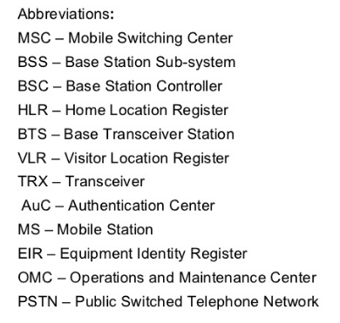
GSM Architecture
PSTN/PLMN
PSTN
VLR
MSC
HLR
AUC
A
EIR
BSS
BSC
BTS
BTS
Um
MS
MS
ME+SIM
Notes:
The base station subsystem (BSS) is the section of a traditional cellular telephone network which is responsible for handling traffic and signaling between a mobile phone and the network switching subsystem.
IMEI-international mobile equipment identifier
IMSI-international mobile subscriber identity
TMSI-Temporary mobile subscriber identity

Slide 8
MS
ME:
Voice encoding and TRX
Frequency and Time synchronization of channel
Voice Encryption and Decryption
Power management
Responsible for Handover
IMEI (IMEI-international mobile equipment identifier) for security purposes
SIM:
Portable smart card
IMSI-international mobile subscriber identity
Ki (128 bits) authentication parameters for authorizing authentication of mobile
Authentication algorithm A3 and ciphering algorithm A8
Encryption Key Kc
Temporary stores TMSI-Temporary Mobile Subscriber Identity, LAI-Location Area Identity, RAI-Routing Area Identity

Slide 9
BTS is Responsible for
Radio interface
Data Transcoding
Voice Encryption and Decryption
Power management
BSC is responsible for
Physical link between BTS and MSC
Monitoring and Controlling BTS
Management of channel on the radio interface

Slide 10
MSC:
It is build to perform switching functionality of the entire system. It’s most important task is to control the calls to and from other telephones, which means it controls calls from same networks and calls from other networks (Switch to one PLMN to PSTN and PSTN to PLMN)
Logging calls
Interface with PSTN, PLMN, ISDN
Mobility management over the radio network and other network
Radio Resource management-handovers between BSCs
Billing information

Slide 11
Home Location Register (HLR)
It is mostly known for storing and managing information of subscribers
It represents a centralized database that has the permanent data about the mobile subscribers (subscriber service profile, status of activities, information about locations) in a large service area (generally one per GSM network operator).
The HLR is kept updated with the current locations of all its mobile subscriber, including those who may have roamed to another network operator within or out side the country. The routing information is obtained from the serving VLR on a call by call basis.
When new connections are purchased, these subscribers are registered in HLR of mobile phone companies.

Slide 12
The Visiting Location register (VLR):
It represents a temporary data store and there is one VLR per MSC. This register contains information about the mobile subscriber who are currently in the service area covered by the MSC/VLR.
when subscribe moves to different MSC location, Visitor location register – VLR integrates to MSC of current location and requests the data about subscriber or Mobile station ( MS ) from the Home Location Register –HLR.
VLR includes:
Features currently activated
MS identity
Current location

Slide 13
Authentication Center (AUC):
AUC is small unit which handles the security end of the system. Its major task is to authenticate and encrypt those parameters which verify user’s identification and hence enables the confidentiality of each call made by subscriber
Generally associated with the HLR,
The authentication center contains authentication parameters that are used on initial location registration, subsequent location updates and on each call set-up request from the MS.
In GSM , Authentication center – AUC makes sure mobile operators are safe from different frauds and protection from unauthorized access is achieved through strong authentication procedures that validate the true identity of subscriber before he or she is permitted to receive service.
The authentication and ciphering functions in GSM are closely linked and are performed as a single procedure between MS and the network.
Notes:
put (a message) into secret writing; encode. In cryptography, a cipher (or cypher) is an algorithm for performing encryption or decryption—a series of well-defined steps that can be followed as a procedure

Slide 14
An authentication algorithm A3, a cipher key generation algorithm A8 and an encryption algorithm A5, individual subscriber authentication key (Ki) are also programmed into the MS at the time of service provisioning. The relevant call flows are shown in fig.1
5
4
3
5
4
3
BSC
MSC
3 4 5
4 3
VLR
MS
1 2
SIM with A3, A5, A8, Ki
HLR

Slide 15
VLR sends IMSI (International Mobile Subscriber Identity) to the HLR.
HLR returns security triplets (RAND, SRES, Kc) to the VLR
For authentication and ciphering the VLR sends RAND to the MS.
Using stored A3 algorithm and secret key Ki stored in the SIM, and RAND provided by the VLR the MS calculates SRES (Signed Response) and returns it to the VLR. Using the A8 algorithm and Ki, The MS also calculates the cipher key Kc.
If the SRES returned by the MS matches with the stored SRES in the VLR, the VLR sends the cipher key Kc to the BTS which uses Kc for ciphering the radio path (down link)
MS uses its Kc to cipher the radio path (uplink) using encryption algorithm)
5
4
3
5
4
3
RAND is randomly generated 128 bit number used
for providing triples always different.
• SRES (signed response) is 32 bit long number
generated by A3 algorithm and used as digital
signature of MS.
• Kc is 64 bit ciphering key generated by A8 algorithm and used for encrypting data between MS
and SGSN.
BSC
MSC
4 3
3 4 5
VLR
MS
1 2
SIM with A3, A5, A8, Ki
HLR

Slide 16
Equipment Identity Register (EIR):
The EIR maintains information to authenticate terminal equipment so that fraudulent, stolen on non-type-approved terminals can be identified and denied service.
AUC – Authentication center and EIR- Equipment Identity registers are either Stand-alone nodes or some times work together as combined AUC/EIR nodes for optimum performance.

Slide 17
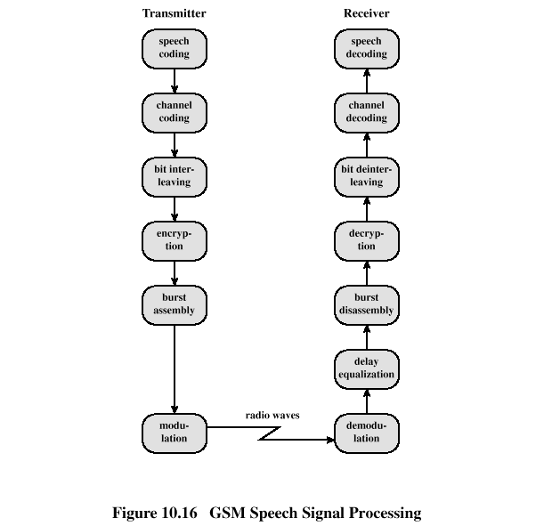
GSM Speech Processing

Slide 18
A. Speech coding:
GSM speech coder is RELP (Residually Excited Predictive Coder), which is enhanced by including a Long Term Predictor (LTP).
The coder provides 260 bits for 20ms blocks of speech, which yields a bit rate of 13kbps.
GSM system operates in Discontinuous Transmission mode (DTX) by incorporating a Voice Activity Detector (VAD) in speech coder. This mode provides a longer battery life and reduces instantaneous radio interference since GSM transmitter is not active during silent periods.
A Comfort Noise Subsystem (CNS) is used at receiver which adds background acoustic noise to compensate for the annoying switched muting which occurs due to DTX.
Notes:
Linear Predictive Coders (LPC) basic Vocoder model:
• Models vocal tract as a filter •
Filter excitation:
• periodic pulse (voiced speech) or noise (unvoiced speech)
• Transmitted parameters: • gain, voiced/unvoiced decision, pitch (if voiced), LPC parameters

Slide 19
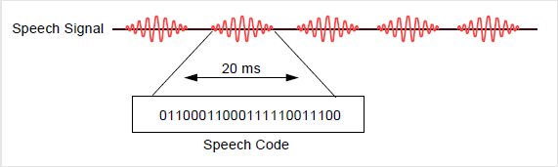
A. Speech coding:
The speech coder removes redundancy in the digital signal (such as silence periods)
This provides a speech quality which is acceptable for mobile telephony and comparable with wireline PSTN phones.

Slide 20
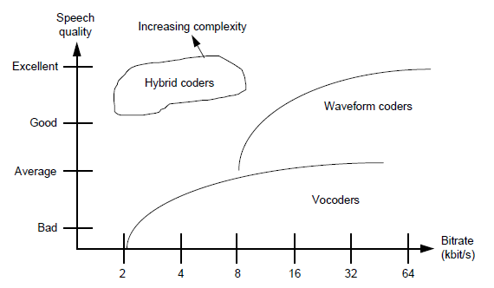
Comparison of speech coders
Many types of speech coders are available. Some offer better speech quality, at the expense of a higher bit rate (waveform coders). Others use lower bit rates, at the expense of lower speech quality (vocoders). The hybrid coder which GSM uses provides good speech quality with a relatively low bit rate, at the expense of speech coder complexity.

Slide 21
B. Channel coding:
The outputs of the speech coder are ordered into for error protection,
Out of 260 bits in a frame, the most important 50 bits called type Ia bits, have 3 parity check (CRC) bits added to them to detect non-correctable errors at the receiver.
The next 132 bits with first 53 are appended by 4 trailing zero bits, thus providing a data block of 189 bits. This block is then encoded for error protection using a rate ½ convolution encoder, thus providing a sequence of 378 bits.
The least important 78 bits do not have error protection and concatenated to existing sequence to form a block of 456 bits in 20ms frame, data rate of speech signal becomes 22.8kbps.
Notes:
A cyclic redundancy check (CRC) is an error-detecting code commonly used in digital networks and storage devices to detect accidental changes to raw data.

Slide 22
Channel coding
13kbps*20ms = 260bits = 50+132+78
50 very important bits
Block Coder
53
Convolution
Coder
1:2
378
132 important bits+ 4tail bits
456
78 not so important bits

Slide 23
C. Interleaving
Interleaving is the reordering of data that is to be transmitted so that consecutive bytes of data are distributed over a larger sequence of data to reduce the effect of burst errors. The use of interleaving greatly increases the ability of error protection codes to correct for burst errors. Many of the error protection coding processes can correct for small numbers of errors, but cannot correct for errors that occur in groups.

Slide 24
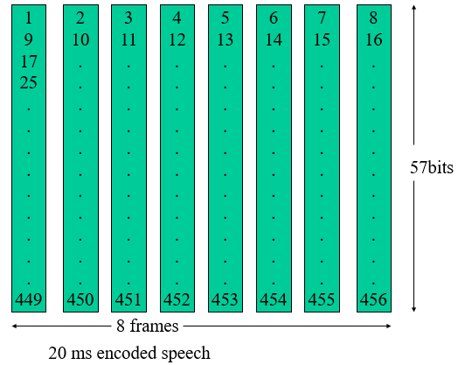
C. Interleaving
First level of interleaving
To minimize the effect of sudden fades on the received data, the total of 456 encoded bits within each 20ms speech frame or control message frame are broken into eight 57 bits sub blocks and they are numbered even odd according to block number. These eight consecutive blocks are spread over eight consecutive TCH time slot.
In a normal burst there is space for two of these speech blocks of 57 bits. Thus, if one burst transmission is lost, there is a 25% BER for the entire 20 ms of speech (2/8 = 25%).

Slide 25
Normal Burst
2*(3 head bit + 57 data bits + 1 signaling bit) + 26 training sequence bit + 8.25 guard bit
Duration of a burst = 576.9 μs ≈ 0.57ms = duration of TS of TDMA frame
If a burst is lost 25% of 20ms speech is lost
Notes:
The normal burst is used to transmit information on traffic and control (except RACH) channels. The bursts are separated through guard bands.
At the start and end of each burst are three tail bits which are always set to logical "0". These bits fill a short t ime span during which transmitter power is ramped up or down and during which no data transmission is possible.
The Stealing Flags (SF) are signalling bits which indicate whether the burst contains traffic data or signalling data.
A normal burst contains besides the synchronization and signalling bits two blocks of 57 bits each of error-protected and channel encoded user data separated by a 26-bit midamble.
This midamble consists of predefined, known bit patterns, the training sequences (discussed in detail later), which are used for channel estimation to optimize reception with an equalizer and for synchronization. With the help of these training sequences, the equalizer eliminates or reduces the intersymbol interferences which are caused by propogation time difference of the multipath propogation.

Slide 26
Second level of interleaving
If only one level of interleaving is used, a loss of this burst results in a total loss of 25%. This is too much for the channel decoder to correct. A second level of interleaving can be introduced to further reduce the possible BER to 12.5%. Instead of sending two blocks of 57 bits from the same 20 ms of speech within one burst, a block from one 20 ms and a block from next sample of 20 ms are sent together. A delay is introduced in the system when the MS must wait for the next 20 ms of speech. However, the system can now afford to loose a whole burst, out of eight, as the loss is only 12.5% of the total bits from each 20ms speech frame. 12.5% is the maximum loss level that channel decoder can correct.

Slide 27
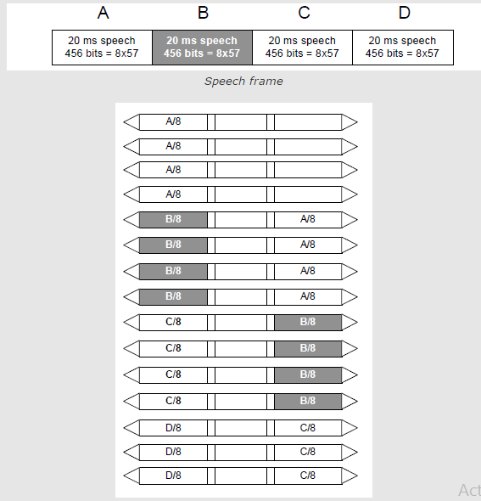
Second level of interleaving

Slide 28
C. Interleaving
Speech
20 ms
20 ms
Speech Coder
Speech Coder
260
260
Channel Encoding
Channel Encoding
456 bit
456 bit
Interleaving
1
2
3
4
5
6
7
8
NORMAL BURST
3
57
1
26
1
57
3
8.25

Slide 29
D. Burst formatting
Burst formatting adds binary data to the data block to help synchronization and equalization of the received signal.
As previously explained, every transmission from an MS/BTS must include some extra information such as the 26 training sequence bits, 2 flag bits and 6 tail bits. The process of burst formatting is to add these bits to the basic speech/data (57+57=114 bits) being sent. Consequently this increases the burst from 114 to 148 bits, thus increasing the transmission rate on the air, but is necessary to counteract problems encountered on the radio path.
Notes:
Equalization is a way of manipulating sounds by Frequency. It allows you to increase the volume of some frequencies and reduce others. High frequencies (above 6000 Hz) and low frequencies (below 100 Hz) are reduced in volume by 20 dB.

Slide 30
D. Burst formatting
In GSM, the input to burst formatting for 20ms speech is the 456 bits received from ciphering. Burst formatting adds 136 bits to it, bringing the sum total to 592. However, each time slot on a TDMA frame is 0.577 ms long. This provides enough time for (148+8.25) 156.25 bits to be transmitted (each bit takes 3.7 μs), but a burst only contains 148 bits. The rest of the space, 8.25 bit times, is empty and is called the GuardPeriod (GP).
This time is used to enable the MS/BTS “ramp up” and “ramp down”. To ramp up means to get power from the battery/power supply for transmission. Ramping down is performed after each transmission to ensure that the MS is not transmitting during time slots allocated to other MS’s. The output of burst formatting is a burst of 156.25 bits(one burst) or 625 bits(four bursts) for 20 ms sample. The transmission bit rate for GSM can be calculated to be 270.9kbits/s(156.25/.577).

Slide 31
E. Ciphering
Ciphering modifies the contents of the eight interleaved blocks by encryption techniques known only to the particular mobile station and base transceiver station.
The A3 ciphering algorithm is used to authenticate each mobile by verifying the user password within the SIM with the cryptographic key at the MSC.
The A5 ciphering algorithm is used for encryption. It provides scrambling for 114 coded bits sent in each TS.
The A8 is used for ciphering key.

Slide 32
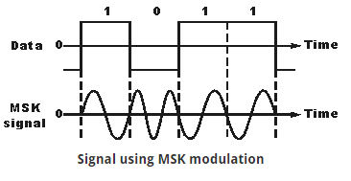
F. Modulation
The modulation scheme used by GSM system is 0.3GMSK where 0.3 describes 3db bandwidth of the Gaussian pulse shaping filter. Modulation block minimizes the occupied BW using GMSK modulation with BT of 0.3. By filtering the transmitted pulses this way, the intersymbol interference caused by the channel can be kept in control.
The channel data rate of GSM is 270.833 kbps which is four times the RF frequency shift. This minimizes bandwidth of the modulation spectrum and hence improves channel capacity.
MSK modulated signal is then passed through Gaussian filter to smooth the rapid frequency transitions which would otherwise spread energy in adjacent channels.
Here there are no phase discontinuities because the frequency changes occur at the carrier zero crossing points. The frequency difference between the logical one and logical zero states is always equal to half the data rate.
Notes:
In electronics and telecommunications, pulse shaping is the process of changing the waveform of transmitted pulses. Its purpose is to make the transmitted signal better suited to its purpose or the communication channel, typically by limiting the effective bandwidth of the transmission. By filtering the transmitted pulses this way, the intersymbol interference caused by the channel can be kept in control. In RF communication, pulse shaping is essential for making the signal fit in its frequency band. BT-Bit Time.
GSM (Global System for Mobile Communications,)

Slide 33
G. Demodulation:
The portion of the transmitted forward channel signal which is of interest to a particular user is determined by the assigned TS and ARFCN. The appropriate TS is demodulated with aid of synchronization data provided by the burst formatting.
In GSM cellular networks, an absolute radio-frequency channel number (ARFCN) is a code that specifies a pair of physical radio carriers used for transmission and reception in a land mobile radio system, one for the uplink signal and one for the downlink signal.
After demodulation the binary information is deciphered, de-interleaved, channel decoded and speech decoded.

Slide 34
Channel Allocation Scheme
Fixed Channel Allocation (FCA)
Channel Borrowing Scheme
Dynamic Channel Allocation (DCA)

Slide 35
Fixed Channel Assignment (FCA)
Permanently assign a fixed set of channels to each cell and reuse them in the co-channel cells
A user is assigned an unoccupied channel on demand, which is relinquishes after the call is over
If the number of calls exceeds the channel set for a cell, the excess calls are blocked
To maximize reuse of the available frequency channels, various graph coloring techniques have been proposed
Does not solve “hot spot” problem
Notes:
Fixed: FCA, fixed channel allocation: manually assigned by the network operator. FCA can be extended into a DCA system by using a borrowing strategy in which a cell can borrow channels from the neighboring cell which is supervised by Mobile Switching Center (MSC).

Slide 36

Notes:
Hotspot is a place of more than usual interest, activity, or popularity.
a place of significant activity, danger, or violence.

Slide 37
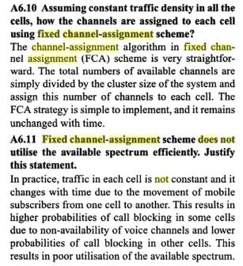
Notes:
Wireless Communications
By Singal

Slide 38
Dynamic Channel Assignment (DCA)
No cell has a proprietary set of channels. Channels are allocated to a user on demand from a central pool on the basis of a cost function.
Two problems that typically occur with DCA based systems.
First, DCA methods typically have a degree of randomness associated with them and this leads to the fact that frequency reuse is often not maximized unlike the case for FCA systems in which cells using the same channel are separated by the minimum reuse distance.
Secondly, DCA methods often involve complex algorithms for deciding which available channel is most efficient. These algorithms can be very computationally intensive and may require large computing resources in order to be real-time.
Notes:
proprietary -registered

Slide 39
Channel Borrowing Scheme
Channel Borrowing is one of the most straightforward hybrid allocation schemes. Here, channels are assigned to cells just as in fixed allocation schemes. If a cell needs a channel in excess of the channels previously assigned to it, that cell may borrow a channel from one of its neighboring cells given that a channel is available and use of this channel won't violate frequency reuse requirements.
The major problem with channel borrowing is that when a cell borrows a channel from a neighboring cell, other nearby cells are prohibited from using the borrowed channel because of co-channel interference. This can lead to increased call blocking over time.
To reduce this call blocking penalty, algorithms are necessary to ensure that the channels are borrowed from the most available neighboring cells; i.e., the neighboring cells with the most unassigned channels.

Slide 40
Simple Borrowing - A channel is borrowed from a neighboring cell provided it does not interfere with existing calls - Performance suffers under heavy traffic conditions
X
C
B
E
B:{b1, b2,..}
a3
A
C
B
D
G
A
a3
A:{a1, a2,…}
E
F
D
B
E
F
A
C
B
E
X
G
A
C
F
D
G
E
F
D
(a)
(b)
FCA: A-G denote different sets of channels permanently assigned to cells
Borrowing: Channel a3 is borrowed by B from A. Cells marked X are prohibited from using a3

Slide 41
Handover (Handoff)
Hand-off is the process of switching from one frequency channel to another by the user in midst of a communication. Hand-off takes place when a user crosses the cell boundary. It Provides continuity of communication across cells. Handoffs must be performed successfully and as infrequently as possible, and be imperceptible to the users.
Process
Received signal weakens as mobile moves out of cell (Minimum usable signal level is normally set to be between -90 dBm and -100 dBm).
A slightly save signal level is used as a threshold at which a handoff is made.
Cell site at some point requests handover to cell with stronger signal strength.
MSC switches call to new cell after allocating channels, and informing the two mobiles of the new channels (voice and control channels).
Notes:
The suffix after dB implies reference
dBm----Reference is milliwatt(mW)
dBῃ------ reference is microwatt
dBmV-----reference is milivolt

Slide 42
Reasons for a Handoff to be conducted
To avoid call termination: call drops
When the capacity for connecting new calls of a given cell is used up.
Interference in the channels.
When the user behaviors change.
Speed and mobility.

Slide 43
Importance of handoff decision time

Slide 44
Three parameters to initiate handoff
Received Signal Strength (RSS)
Signal-to-Noise Ratio (SNR)
Bit Error Rate (BER)
The quality of the RSS from the mobile station is monitored by the BS. When the RSS is below a certain threshold. BS instructs the mobile station to collect signal strength measurements from neighboring BSs
Case 1: mobile station sends the collected information to the BS. BS conveys the signal information to its parent MSC (mobile switching center) which selects the most suitable next BS for the mobile station Both the selected BS and the mobile station are informed when new BS assigns an unoccupied channel to the mobile station
Case 2: mobile station itself selects the most suitable BS. The mobile station informs the current BS, who conveys information about the next BS to its MSC The selected BS is informed by the MSC which assigns a new channel
Notes:
The bit error rate (BER) is the number of bit errors per unit time. It is the rate at which errors occur in the transmission of digital data.

Slide 45
Handover Process (1)

Slide 46
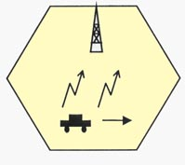
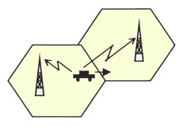
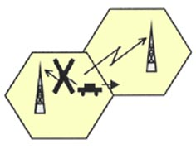
Handoff Types
Intra-Cell
Inter-Cell
Soft Handoff
Hard Handoff

Slide 47
INTER-CELL AND INTRA-CELL HANDOVER
The inter-cell handover switches a call in progress from one cell to another cell, and the intra-cell handover switches a call in progress from one physical channel of a cell to another physical channel of the same cell.

Slide 48
HARD HANDOVER
“BREAK BEFORE MAKE”
Old connection is broken before a new connection is activated
Primarily used in FDMA and TDMA systems (e.g. GSM)
Different frequency ranges used in adjacent cells to minimize the interference

Slide 49
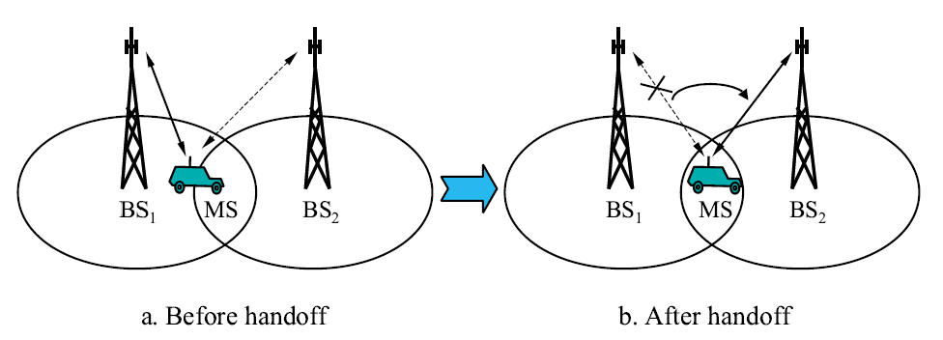
Mechanism of Hard Handover
The base station BS₁ on one cell site hands off the mobile station(MS)’s call to another cell BS₂.
The link to the prior base station, BS₁ is terminated before the user is transferred to the new cell’s base station, BS₂. The MS is linked to no more than one BS at any given time.

Slide 50
CHARACTERISTICS
A Hard handover is relatively cheaper and easier to implement in comparison to other types of Handover.
It is primarily used in FDMA (frequency division multiple access) and TDMA (time division multiple access), where different frequency ranges are used in adjacent channels in order to minimize channel interference.
It is simpler as phone's hardware does not need to be capable of receiving two or more channels in parallel.

Slide 51
SOFT HANDOVER
“MAKE BEFORE BREAK”
New connection is activated before the old is broken
Used in UMTS to improve the signal quality
Uplink and downlink signals may be combined for better signal
A mobile may in UMTS spend a large part of the connection time in soft handover
Better connection reliability
More seamless handover.
Notes:
The Universal Mobile Telecommunications System (UMTS) is a third generation mobile cellular system for networks based on the GSM standard

Slide 52
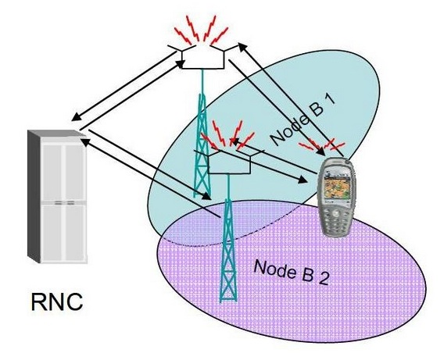
MECHANISM OF SOFT HANDOVER
Radio Network Controller
controlling the BS
Notes:
The Radio Network Controller (or RNC) is a governing element in the UMTS radio access network (UTRAN) and is responsible for controlling the Node Bs that are connected to it. The RNC carries out radio resource management, some of the mobility management functions and is the point where encryption is done before user data is sent to and from the mobile. The RNC connects to the Circuit Switched Core Network through Media Gateway (MGW) and to the SGSN (Serving GPRS Support Node) in the Packet Switched Core Network.

Slide 53
The call is first connected to the new base station BS₂ and then it is dropped by the previous base station BS₁.
The call will be established only when a reliable connection to the target cell is obtained. The MS is linked to two BS for a brief interval of time. Thus soft handover involves connection to more than one cell.
SOFT HANDOVER

Slide 54
CHARACTERISTICS
It offers more reliable access continuity in network connection and less chances of a call termination during switching of base stations in comparison to a Hard handoff.
It is commonly used in CDMA (Code-division multiple access) systems that enables the overlapping of the repeater coverage zones, so that every cell phone set is always well within range of at least one of the base stations.
Technical implementation of a Soft handoff is more expensive and complex in comparison to a Hard handoff.
It is used in sensitive communication services such as videoconferencing.

Slide 55
Cell Sectoring by Antenna Design
c
c
120º
120º
a
b
a
b
(a). Omni
(b). 120º sector
(c). 120º sector (alternate)
d
f
90º
e
60º
a
a
c
d
b
b
c
(d). 90º sector
(e). 60º sector

Slide 56
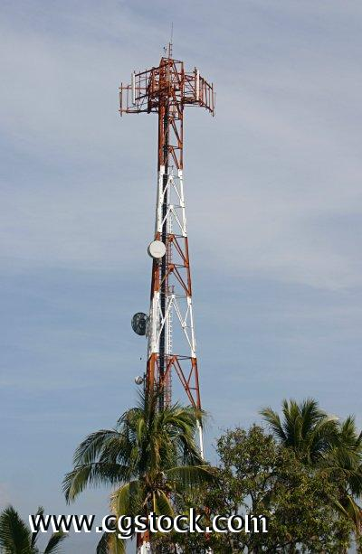
Sectorized Antennas
Further interference reduction by using sectorized antennas.

Slide 57
Cell Sectoring by Antenna Design
Placing directional transmitters at corners where three
adjacent cells meet
B
C
X
A

Slide 58
Worst Case for Forward Channel Interference in Three-sectors
BS
D + 0.7R
BS
MS
R
BS
D
BS

Slide 59
Worst Case for Forward Channel Interference in Six-sectors
MS
BS
R
D +0.7R
BS

Slide 60
Cell Splitting
Often large cells need to be split into smaller ones because the population of users in the big cell has increased beyond what it can support
Cell splitting increases system capacity
Is used in high density subscriber areas (eg. Water Front)
Results to increased costs (eg. new base stations)
Difficult to maintain coverage boundary

Slide 61
Cell Splitting
2
1
2
3
2
1
3
7
1
3
7
6
4
6
4
7
5
5
6
4
5

Slide 62
Cell Splitting
Large cell (low density)
Small cell (high density)
Smaller cell (higher density)
Depending on traffic patterns the smaller cells may be activated/deactivated in order to efficiently use cell resources.

Slide 63
Frequency Planning

Slide 64

Frequency Planning
Mobile cellular communication is a full duplex system where the entire allocated bandwidth of a service provider is divided into two equal halves: one half is for uplink channels and the other half for down link channels. A guard band of 45MHz is maintained between up and down link channel of a particular call to avoid interference.

Slide 65
AMPS has two different band named Band-A and band-B, each has 12.5 MHz band of frequency (10MHz is called non-expanded spectrum and 2.5 MHz is the expanded spectrum). Channel spacing in AMPS is 30 KHz therefore total 12.5 MHz/30KHz = 416 channels are available for each band among them 21 channels are used as control channel and the remaining 395 for voice call.
Notes:
Advanced Mobile Phone Service

Slide 66
Band A Frequency for 7/21 pattern
1A | 2A | 3A | 4A | 5A | 6A | 7A | 1B | 2B | 3B | 4B | 5B | 6B | 7B | 1C | 2C | 3C | 4C | 5C | 6C | 7C
1 | 2 | 3 | 4 | 5 | 6 | 7 | 8 | 9 | 10 | 11 | 12 | 13 | 14 | 15 | 16 | 17 | 18 | 19 | 20 | 21
22 | 23 | 24 | 25 | 26 | 27 | 28 | 29 | 30 | 31 | 32 | 33 | 34 | 35 | 36 | 37 | 38 | 39 | 40 | 41 | 42
43 | 44 | 45 | 46 | 47 | 48 | 49 | 50 | 51 | 52 | 53 | 54 | 55 | 56 | 57 | 58 | 59 | 60 | 61 | 62 | 63
64 | 65 | 66 | 67 | 68 | 69 | 70 | 71 | 72 | 73 | 74 | 75 | 76 | 77 | 78 | 79 | 80 | 81 | 82 | 83 | 84
85 | 86 | 87 | 88 | 89 | 90 | 91 | 92 | 93 | 94 | 95 | 96 | 97 | 98 | 99 | 100 | 101 | 102 | 103 | 104 | 105
106 | 107 | 108 | 109 | 110 | 111 | 112 | 113 | 114 | 115 | 116 | 117 | 118 | 119 | 120 | 121 | 122 | 123 | 124 | 125 | 126
127 | 128 | 129 | 130 | 131 | 132 | 133 | 134 | 135 | 136 | 137 | 138 | 139 | 140 | 141 | 142 | 143 | 144 | 145 | 146 | 147
148 | 149 | 150 | 151 | 152 | 153 | 154 | 155 | 156 | 157 | 158 | 159 | 160 | 161 | 162 | 163 | 164 | 165 | 166 | 167 | 168
169 | 170 | 171 | 172 | 173 | 174 | 175 | 176 | 177 | 178 | 179 | 180 | 181 | 182 | 183 | 184 | 185 | 186 | 187 | 188 | 189
190 | 191 | 192 | 193 | 194 | 195 | 196 | 197 | 198 | 199 | 200 | 201 | 202 | 203 | 204 | 205 | 206 | 207 | 208 | 209 | 210
211 | 212 | 213 | 214 | 215 | 216 | 217 | 218 | 219 | 220 | 221 | 222 | 223 | 224 | 225 | 226 | 227 | 228 | 229 | 230 | 231
232 | 233 | 234 | 235 | 236 | 237 | 238 | 239 | 240 | 241 | 242 | 243 | 244 | 245 | 246 | 247 | 248 | 249 | 250 | 251 | 252
253 | 254 | 255 | 256 | 257 | 258 | 259 | 260 | 261 | 262 | 263 | 264 | 265 | 266 | 267 | 268 | 269 | 270 | 271 | 272 | 273
274 | 275 | 276 | 277 | 278 | 279 | 280 | 281 | 282 | 283 | 284 | 285 | 286 | 287 | 288 | 289 | 290 | 291 | 292 | 293 | 294
295 | 296 | 297 | 298 | 299 | 300 | 301 | 302 | 303 | 304 | 305 | 306 | 307 | 308 | 309 | 310 | 311 | 312
313 | 314 | 315 | 316 | 317 | 318 | 319 | 320 | 321 | 322 | 323 | 324 | 325 | 326 | 327 | 328 | 329 | 330 | 331 | 332 | 333
 |  |  |  |  |  |  |  |  |  |  |  |  |  |  | 667 | 668 | 669 | 670 | 671 | 672
673 | 674 | 675 | 676 | 677 | 678 | 679 | 680 | 681 | 682 | 683 | 684 | 685 | 686 | 687 | 688 | 689 | 690 | 691 | 692 | 693
694 | 695 | 696 | 697 | 698 | 699 | 700 | 701 | 702 | 703 | 704 | 705 | 706 | 707 | 708 | 709 | 710 | 711 | 712 | 713 | 714
715 | 716
 |  |  |  |  |  |  |  |  | 991 | 992 | 993 | 994 | 995 | 996 | 997 | 998 | 999 | 1000 | 1001 | 1002
1003 | 1004 | 1005 | 1006 | 1007 | 1008 | 1009 | 1010 | 1011 | 1012 | 1013 | 1014 | 1015 | 1016 | 1017 | 1018 | 1019 | 1020 | 1021 | 1022 | 1023

Slide 67
Band B Frequency for 7/21 pattern
1A | 2A | 3A | 4A | 5A | 6A | 7A | 1B | 2B | 3B | 4B | 5B | 6B | 7B | 1C | 2C | 3C | 4C | 5C | 6C | 7C
334 | 335 | 336 | 337 | 338 | 339 | 340 | 341 | 342 | 343 | 344 | 345 | 346 | 347 | 348 | 349 | 350 | 351 | 352 | 353 | 354
355 | 356 | 357 | 358 | 359 | 360 | 361 | 362 | 363 | 364 | 365 | 366 | 367 | 368 | 369 | 370 | 371 | 372 | 373 | 374 | 375
376 | 377 | 378 | 379 | 380 | 381 | 382 | 383 | 384 | 385 | 386 | 387 | 388 | 389 | 390 | 391 | 392 | 393 | 394 | 395 | 396
397 | 398 | 399 | 400 | 401 | 402 | 403 | 404 | 405 | 406 | 407 | 408 | 409 | 410 | 411 | 412 | 413 | 414 | 415 | 416 | 417
418 | 419 | 420 | 421 | 422 | 423 | 424 | 425 | 426 | 427 | 428 | 429 | 430 | 431 | 432 | 433 | 434 | 435 | 436 | 437 | 438
439 | 440 | 441 | 442 | 443 | 444 | 445 | 446 | 447 | 448 | 449 | 450 | 451 | 452 | 453 | 454 | 455 | 456 | 457 | 458 | 459
460 | 461 | 462 | 463 | 464 | 465 | 466 | 467 | 468 | 469 | 470 | 471 | 472 | 473 | 474 | 475 | 476 | 477 | 478 | 479 | 480
481 | 482 | 483 | 484 | 485 | 486 | 487 | 488 | 489 | 490 | 491 | 492 | 493 | 494 | 495 | 496 | 497 | 498 | 499 | 500 | 501
502 | 503 | 504 | 505 | 506 | 507 | 508 | 509 | 510 | 511 | 512 | 513 | 514 | 515 | 516 | 517 | 518 | 519 | 520 | 521 | 522
523 | 524 | 525 | 526 | 527 | 528 | 529 | 530 | 531 | 532 | 533 | 534 | 535 | 536 | 537 | 538 | 539 | 540 | 541 | 542 | 543
544 | 545 | 546 | 547 | 548 | 549 | 550 | 551 | 552 | 553 | 554 | 555 | 556 | 557 | 558 | 559 | 560 | 561 | 562 | 563 | 564
565 | 566 | 567 | 568 | 569 | 570 | 571 | 572 | 573 | 574 | 575 | 576 | 577 | 578 | 579 | 580 | 581 | 582 | 583 | 584 | 585
586 | 587 | 588 | 589 | 590 | 591 | 592 | 593 | 594 | 595 | 596 | 597 | 598 | 599 | 600 | 601 | 602 | 603 | 604 | 605 | 606
607 | 608 | 609 | 610 | 611 | 612 | 613 | 614 | 615 | 616 | 617 | 618 | 619 | 620 | 621 | 622 | 623 | 624 | 625 | 626 | 627
628 | 629 | 630 | 631 | 632 | 633 | 634 | 635 | 636 | 637 | 638 | 639 | 640 | 641 | 642 | 643 | 644 | 645 | 646 | 647 | 648
649 | 650 | 651 | 652 | 653 | 654 | 655 | 656 | 657 | 658 | 659 | 660 | 661 | 662 | 663 | 664 | 665 | 666
 |  |  |  |  | 717 | 718 | 719 | 720 | 721 | 722 | 723 | 724 | 725 | 726 | 727 | 728 | 729 | 730 | 731 | 732
733 | 734 | 735 | 736 | 737 | 738 | 739 | 740 | 741 | 742 | 743 | 744 | 745 | 746 | 747 | 748 | 749 | 750 | 751 | 752 | 753
754 | 755 | 756 | 757 | 758 | 759 | 760 | 761 | 762 | 763 | 764 | 765 | 766 | 767 | 768 | 769 | 770 | 771 | 772 | 773 | 774
775 | 776 | 777 | 778 | 779 | 780 | 781 | 782 | 783 | 784 | 785 | 786 | 787 | 788 | 789 | 790 | 791 | 792 | 793 | 794 | 795
796 | 797 | 798 | 799

Slide 68
N=7 cell pattern
In N=7 cell cluster of omni three frequency groups of table 2 or 3 is used per cell following the sequence (N, N+7,N+14) where N is the cell number. The channel isolation within a cell is 7×30KHz=210KHz. The channel isolation of adjacent cell is 30KHz between cell 1 and 2 and that of 1 and 3 is 60KHz etc.The separation between adjacent cell,
3
3,10,17
1.5R
4.33R
6
6,13,20
5
5,12,19
3
3,10,17
1
1,8,15
6
6,13,20
5
5,12,19
4
4,11,18
7
7,14,21
1
1,8,15
2
2,9,16
4
4,11,18
7
7,14,21
3
3,10,17
2
2,9,16
6
6,13,20
5
5,12,19
dB
1
1,8,15
4
4,11,18
7
7,14,21
; taking number of co-channel interference j=6, propagation constant γ=4
2
2,9,16

Slide 69
Sometimes cell cluster is formed arranging the cells in two rows like fig.2 having alternate channel assignments known as trapezoidal plan. Here the minimum separation between adjacent channel cells is 2×30=60KHz; better than the previous one.
dB
1
1,8,15
5
5,12,19
2
2,9,16
6
6,13,20
≈8R
1.5R
3
3,10,17
7
7,14,21
4
4,11,18
1
1,8,15
5
5,12,19
2
2,9,16
6
6,13,20
1
1,8,15
5
5,12,19
2
2,9,16
6
6,13,20
3
3,10,17
7
7,14,21
4
4,11,18
3
3,10,17
7
7,14,21
4
4,11,18
1
1,8,15
5
5,12,19
2
2,9,16
6
6,13,20
3
3,10,17
7
7,14,21
4
4,11,18
≈8.1R

Slide 70
N=9 Omni Frequency Plan
Here the available channels are divided into 9 or multiples of 9 groups like table-2
Table-2
1 | 2 | 3 | 4 | 5 | 6 | 7 | 8 | 9 | 10 | 11 | 12 | 13 | 14 | 15 | 16 | 17 | 18
19 | 20 | 21 | 22 | 23 | 24 | 25 | 26 | 27 | 28 | 29 | 30 | 31 | 32 | 33 | 34 | 35 | 36
37 | 38 | 39 | 40 | 41 | 42 | 43 | 44 | 45 | 46 | 47 | 48 | 49 | 50 | 51 | 52 | 53 | 54
55 | 56 | 57 | 58 | 59 | 60 | 61 | 62 | 63 | 64 | 65 | 66 | 67 | 68 | 69 | 70 | 71 | 72
73 | 74 | 75 | 76 | 77 | 78 | 79 | 80 | 81 | 82 | 83 | 84 | 85 | 86 | 87 | 88 | 89 | 90
91 | 92 | 93 | 94 | 95 | 96 | 97 | 98 | 99 | 100 | 101 | 102 | 103 | 104 | 105 | 106 | 107 | 108
109 | 110 | 111 | 112 | 113 | 114 | 115 | 116 | 117 | 118 | 119 | 120 | 121 | 122 | 123 | 124 | 125 | 126
127 | 128 | 129 | 130 | 131 | 132 | 133 | 134 | 135 | 136 | 137 | 138 | 139 | 140 | 141 | 142 | 143 | 144
145 | 146 | 147 | 148 | 149 | 150 | 151 | 152 | 153 | 154 | 155 | 156 | 157 | 158 | 159 | 160 | 161 | 162

Slide 71
The cell is in the form of array like fig.4. In this scheme there is no adjacent channels within the cell cluster like N=7 cells pattern. Because of rhombic pattern only vertical and horizontal expansion is possible like fig.5
The array is,
1
3
5
7
9
2
1
3
5
8
4
6
1
3
5
7
9
2
7
9
2
4
6
8
4
6
8
1
3
5
1
3
5
7
9
2
7
9
2
4
6
8
4
6
8

Slide 72
120-Deg Sectorization
In this scheme a cell is divided into three sectors of 120 deg each like fig.1 where each sector is treated as a logical OMNI cell. Three directional antennas are used at the center of the cell with 120 deg apart to illuminate each sector. Fig.2. shows an alternate representation known as the tricellular plan. Each sector contains one control channel and several voice channels. Adequate channel isolation is necessary within and between sectors to avoid co-site and adjacent channel interference.
Sector-1
Sector-2
Sector-2
Sector-1
Sector-3
Sector-3
(a) Conventional representation (b) Alternate representation

Slide 73
In N=7/21 cluster each cell of N=7 OMNI cluster is divided into three sectors and one frequency group per sector is allocated based on (N, N+7, N+14) distribution where N=1,2,3, …, 7 are the number of cells. For example for N=3, (3, 10, 17) i.e. frequency group 3 for sector 1, frequency group 10 for sector 2 and frequency group 17 for sector 3 of third cell.
1
8
6
6
6
13
3
3
10
1
8
15
1
8
4
3
20
17
15
1
8
15
4
4
11
1
1
8
5
5
12
1
1
8
15
1
8
18
15
19
2
5
15
1
8
15
2
2
9
7
7
14
7
16
21
15
(b) N=7/21 traicellular plan
Fig.1 (a) N=7/21 sectored configuration

Slide 74
N=4/24 Tricellular Plan
In N=4 tricellular plan there are 4 traicells and 12 logical cells/sectors. Here channel assignment is based on 4×3 array, requires 12 or multiple of 12 frequency groups like fig.1.
1
3
5
7
9
11
2
4
6
8
10
12
Fig. N=4 tricellular plan
For 24 frequency groups of table-2 can be distributed among 12 logical cells/sectors using the form, N+12; where N=1, 2, 3 ,…, 12.

Slide 75
Logical cell 1: Frequency groups: (1, 13)
Logical cell 2: Frequency groups: (2, 14)
Logical cell 3: Frequency groups: (3, 15)
………………………………………….
………………………………………….
………………………………………….
Logical cell 12: Frequency groups: (12, 24)
The growth plan is based on repeating the 4×3 array vertically and horizontally like fig.4

Slide 76
1
3
5
7
1
3
5
7
9
11
2
4
9
11
2
4
6
8
10
12
6
8
10
12
1
3
5
7
1
3
5
7
9
11
2
4
9
11
2
4
6
8
10
12
6
8
10
12
Fig. The N=4 tricellular growth

Slide 77
N=4/24 Band A Frequency Chart
1 | 2 | 3 | 4 | 5 | 6 | 7 | 8 | 9 | 10 | 11 | 12 | 13 | 14 | 15 | 16 | 17 | 18 | 19 | 20 | 21 | 22 | 23 | 24
25 | 26 | 27 | 28 | 29 | 30 | 31 | 32 | 33 | 34 | 35 | 36 | 37 | 38 | 39 | 40 | 41 | 42 | 43 | 44 | 45 | 46 | 47 | 48
49 | 50 | 51 | 52 | 53 | 54 | 55 | 56 | 57 | 58 | 59 | 60 | 61 | 62 | 63 | 64 | 65 | 66 | 67 | 68 | 69 | 70 | 71 | 72
73 | 74 | 75 | 76 | 77 | 78 | 79 | 80 | 81 | 82 | 83 | 84 | 85 | 86 | 87 | 88 | 89 | 90 | 91 | 92 | 93 | 94 | 95 | 96
97 | 98 | 99 | 100 | 101 | 102 | 103 | 104 | 105 | 106 | 107 | 108 | 109 | 110 | 111 | 112 | 113 | 114 | 115 | 116 | 117 | 118 | 119 | 120
121 | 122 | 123 | 124 | 125 | 126 | 127 | 128 | 129 | 130 | 131 | 132 | 133 | 134 | 135 | 136 | 137 | 138 | 139 | 140 | 141 | 142 | 143 | 144
145 | 146 | 147 | 148 | 149 | 150 | 151 | 152 | 153 | 154 | 155 | 156 | 157 | 158 | 159 | 160 | 161 | 162 | 163 | 164 | 165 | 166 | 167 | 168
169 | 170 | 171 | 172 | 173 | 174 | 175 | 176 | 177 | 178 | 179 | 180 | 181 | 182 | 183 | 184 | 185 | 186 | 187 | 188 | 189 | 190 | 191 | 192
193 | 194 | 195 | 196 | 197 | 198 | 199 | 200 | 201 | 202 | 203 | 204 | 205 | 206 | 207 | 208 | 209 | 210 | 211 | 212 | 213 | 214 | 215 | 216
217 | 218 | 219 | 220 | 221 | 222 | 223 | 224 | 225 | 226 | 227 | 228 | 229 | 230 | 231 | 232 | 233 | 234 | 235 | 236 | 237 | 238 | 239 | 240

Slide 78
Cyclic Distribution of Channels:
Here channel distribution is based on (N, N+4, N+8) where cell number N=1, 2,3 4. The cell cluster consists of four tricells and 12 logical cells/sectors. If cell 1 is assumed to be in the center, the surrounding pattern will be 2, 3, 4, 2, 3, 4. Similarly if cell 2 is in the center the surrounding pattern will be 1, 3, 4,1 ,3, 4. Likewise if cell 3 is in the center the surrounding pattern will be 1, 2, 4,1 ,2, 4 and if cell 4 is in the center the surrounding pattern will be 1, 2, 3,1 ,2, 3
5
9
1
8
12
1
6
10
4
2
4
7
11
2
3
3
Fig.3 N=4 tricellular pattern

Slide 79
3
2
2
4
1
4
1
3
4
Case-1
2
4
Case-3
1
3
2
3
2
1
4
1
3
4
2
4
3
Case-4
1
1
Case-2
3
2
Fig.5 Growth of N=4 tricellular plan when cell i = 1, 2,3 , 4 is in the center

Slide 80
7
11
3
6
10
3
8
12
2
4
2
5
9
4
1
8
12
1
6
10
4
2
4
7
11
2
3
3
Fig.5 Growth of N=4 tricellular plan when cell 1 is in the center

Slide 81
N=4/24, 60 deg Sectored Plan
Here a cell is divided into six sectors of 60 deg each shown in fig.1 where each sector is treated as a logical cell. Sine narrow cell is used therefore a cell can be repeated more often hence capacity of the network is enhanced. This type of cell sectoring technique is suitable for urban area.
In N=4/24, 60 deg sectored plan, the available channels are divided into 24 frequency groups, distributed evenly among four 60 deg sectors, one frequency group per sector. Heavilty directional antennas are used in each sector to ensure adequate channel isolation between sectors and better adjacent channel C/I performance throughout the network. Channel assignment is based on the following sequence (N, N+4, N+8, N+12, N+16, N+20) where N is the cell number (N+1, 2, 3 and 4 )

Slide 82
21
1
17
1
5
13
9
24
4
22
2
21
1
20
4
8
18
2
6
17
1
5
16
12
14
10
13
9
23
3
24
4
22
2
19
3
7
20
4
8
18
2
6
Sector-1
15
11
16
12
14
10
Sector-6
Sector-2
23
3
Sector-5
Sector-3
19
3
7
Sector-4
15
11
Fig.1 N=4/24 cell pattern

Slide 83
HANDOFF DECISIONS
There are numerous methods for performing handoff. From the decision process point of view, one can find at least three different kinds of handoff decisions.
Network-Controlled Handoff
Mobile-Assisted Handoff
Mobile-Controlled Handoff

Slide 84
Network-Controlled Handoff
In a network-controlled handoff protocol, the network makes a handoff decision based on the measurements of the MSs at a number of BSs.
In general, the handoff process takes 100–200 ms.
Network-controlled handoff is used in first-generation analog systems such as AMPS (Advanced Mobile Phone System), TACS(Total Access Communication System), and NMT (Nordic Mobile Telephone).
Mobile-Assisted Handoff
In a mobile-assisted handoff process, the MS makes measurements and the network makes the decision.
In the circuit-switched GSM (global system mobile), the BS controller (BSC) is in charge of the radio interface management. This mainly means allocation and release of radio channels and handoff management.
The handoff time between handoff decision and execution in a circuit-switched GSM is approximately 1 second.

Slide 85
Mobile-Controlled Handoff
In mobile-controlled handoff, each MS is completely in control of the handoff process.
This type of handoff has a short reaction time (in the order of 0.1 second).
MS measures the signal strengths from surrounding BSs and interference levels on all channels.
A handoff can be initiated if the signal strength of the serving BS is lower than that of another BS by a certain threshold.

Slide 86
HANDOFF FAILURES
Because frequencies cannot be reused in adjacent cells, when a user moves from one cell to another, a new frequency must be allocated for the call.
If a user moves into a cell when all available channels are in use, the user’s call must be terminated.
Problem of signal interference where adjacent cells overpower each other resulting in receiver desensitization is also there.

Slide 87
THANK YOU…

Slide 88
Thank You

Slide 89
Thank you

